Slide 1

Individual Digital solution
SACE ID: 878432H

Slide 2
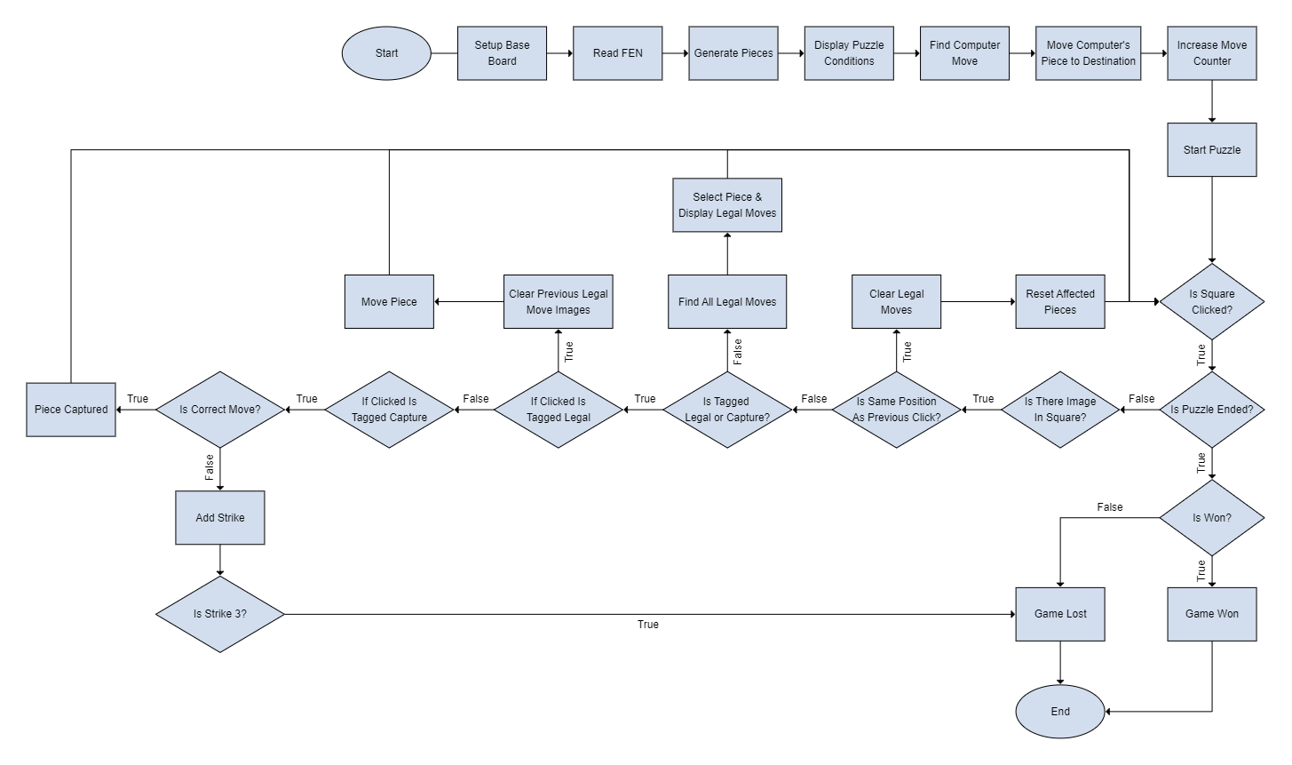
Flowchart

Slide 3
UI Designs
Moves
Board
Sketch 1
Details
Sketch 2
Sketch 3
Details
moves
Board
Board
Scores

Slide 4
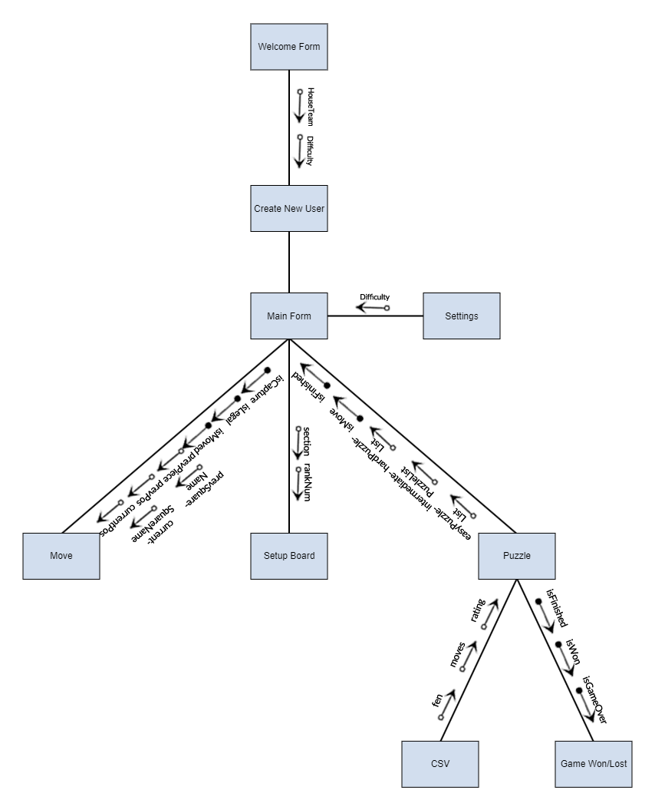
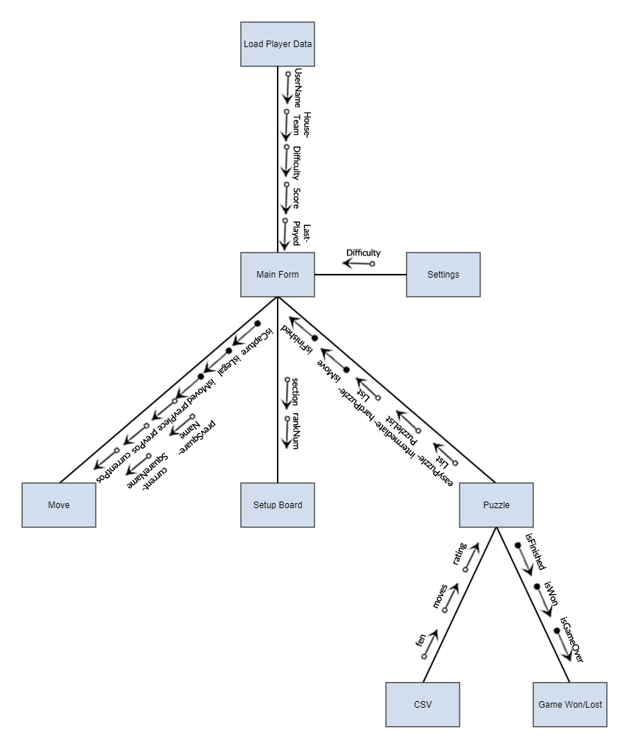
Structure Chart
New User
Previous User

Slide 5



Iteration 1: Reading the FEN
FEN = <Piece Placement> <Side to Move> <Castling Ability> <En Passsant Target Square> <Halfmove Clock> <Fullmove Counter>
1
one empty square
p
black pawn
3
three empty squares
q
black queen
b
black bishop
Q
white queen
The FEN description of this rank is:
“1p3qbQ”
Follows the pattern:
“<rank1>/<rank2>/<rank3>/<rank4>/<rank5>/<rank6>/<rank7>/<rank8>”

Slide 6
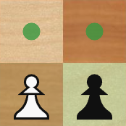
Iteration 1: Reading the FEN
FEN = <Piece Placement> <Side to Move> <Castling Ability> <En Passsant Target Square> <Halfmove Clock> <Fullmove Counter>
IF white to move = “w”
IF black to move = “b”
Can take the form of “w” or “b”
e6
f6
IF white kingside = “K”
IF white queenside = “Q”
IF black kingside = “k”
IF black queenside = “q”
IF none = “-”
Can take the form of “KQkq”
e5
f5
IF en passant available = target square (i.e. f6)
IF en passant unavailable = “-”

Slide 7
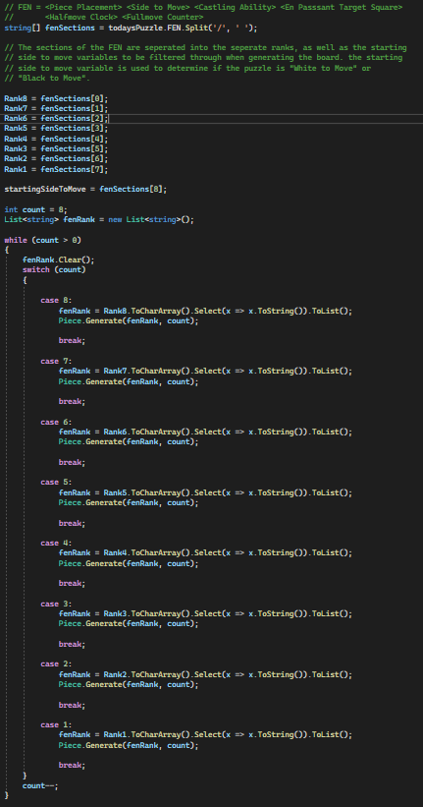
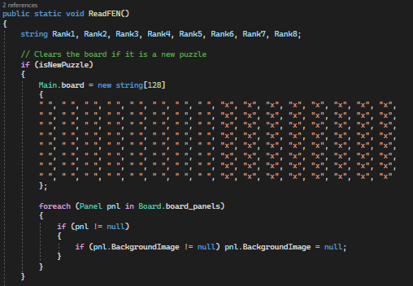
Iteration 1: READING THE FEN

Slide 8
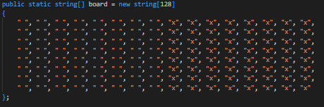
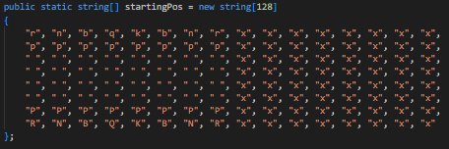
Iteration 1: Board Representation (0x88)
In the background of this application, the representation of the board is important as it is the array of the board behind the visible board, which is utilised in move generation and move checking to determine if a move is legal or not. When programming the board representation, there are two main ways that it can be addressed. This can be through implementing Bitboards, which is a set of 64 elements, which represent all squares of the board, with one bit associated with each square. However, I did not find this as useful to me as using the square centric method of 0x88 to illustrate the board. 0x88 represents the board in 128-byte array, with only half of the array representing valid squares on the board. Within the initial board representation, half of the array elements consist of a blank entry, with the other half containing x’s. Another example of this being used is in the starting position array, which illustrates where each piece starts on the board in a standard game. It can be seen that as usual, the lower and upper two ranks that contain the pieces are regularly seen, however being surrounded by both open strings and x’s.

Slide 9
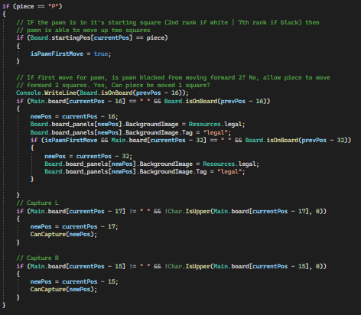
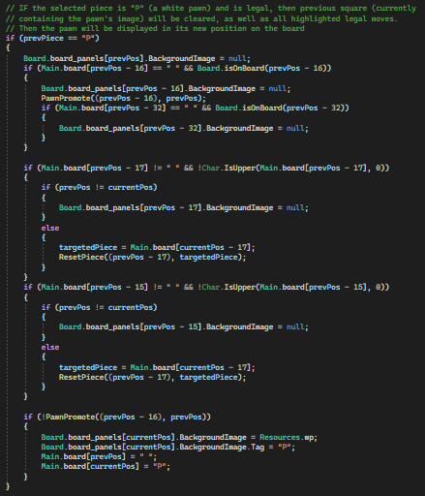

Iteration 1: MOVE GENERATION

Slide 10
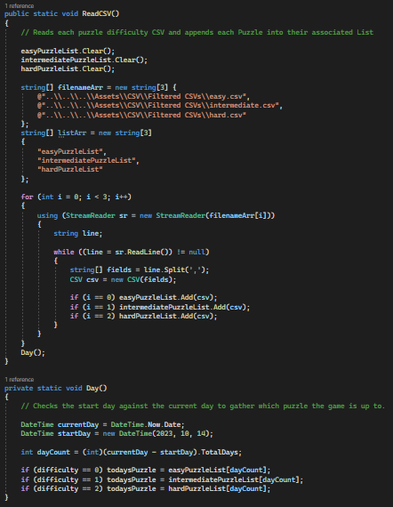
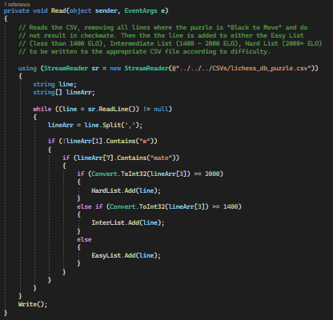
Iteration 2: csv
EVIDENCE OF
WORKING

Slide 11
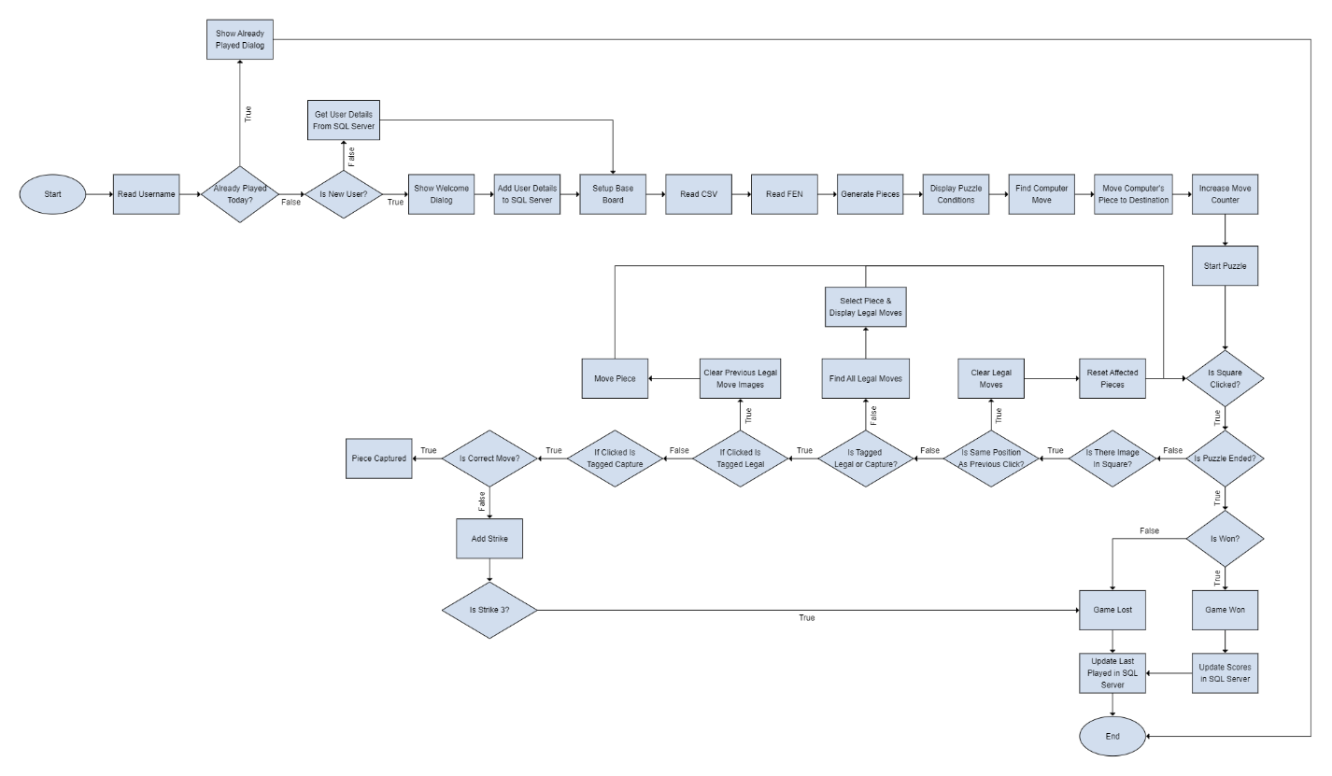
Iteration 3: SQL
EVIDENCE OF
WORKING

Slide 12
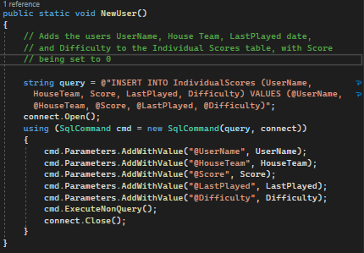
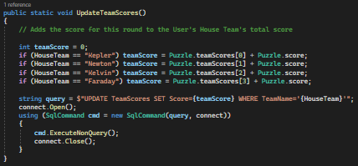
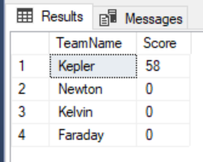


Iteration 3: SQL
CSV Name | Lines
easy.csv | 321,162
intermediate.csv | 91,440
hard.csv | 12,953
lichess_db_puzzle.csv | 3,431,723
EVIDENCE OF
WORKING

Slide 13
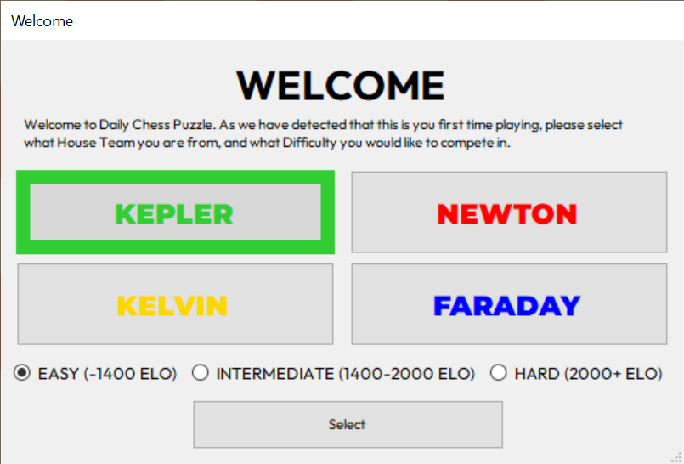
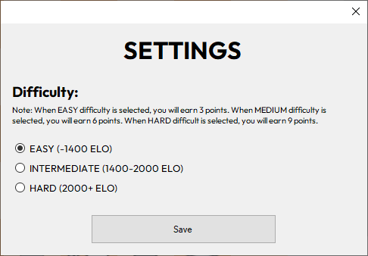
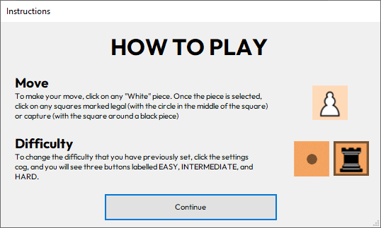
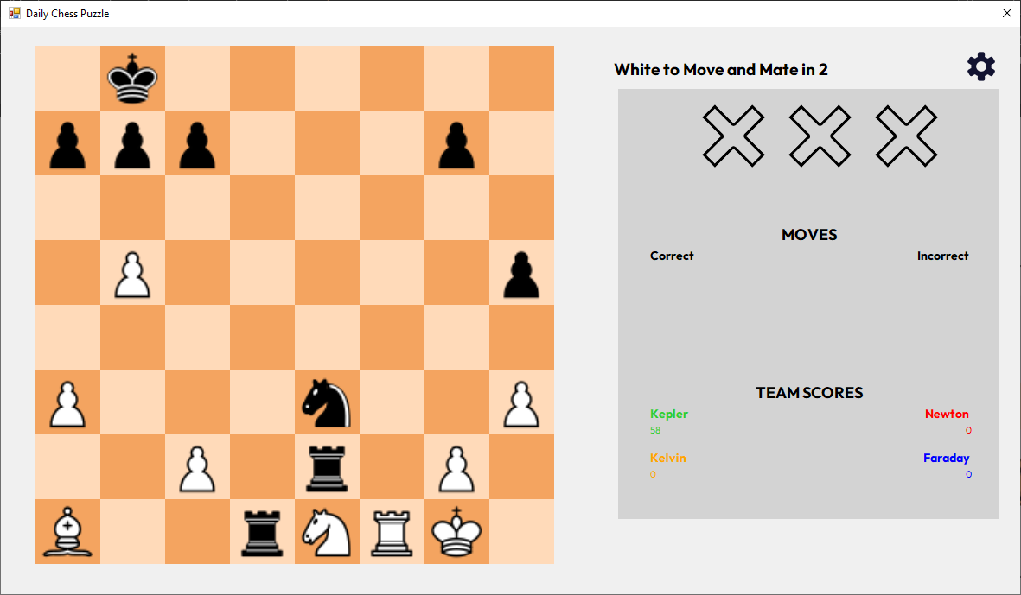
User interface and experience
EVIDENCE OF
WORKING

Slide 14
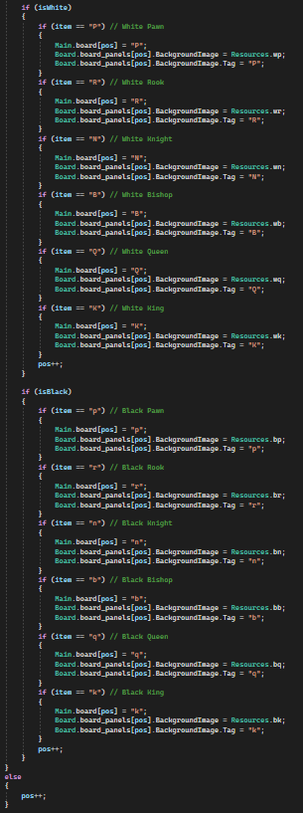
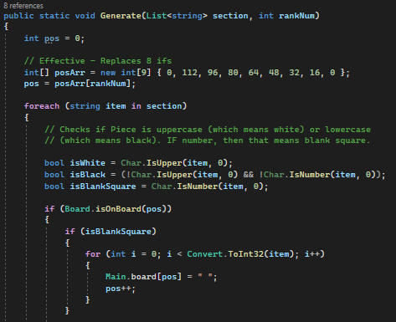
DESIGNER’S STATEMENT: ARRAY IMPLEMENTATION

Slide 15
EVIDENCE OF
WORKING

Slide 16
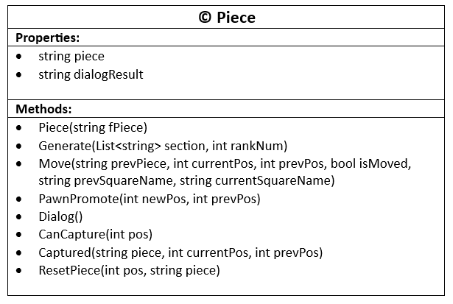
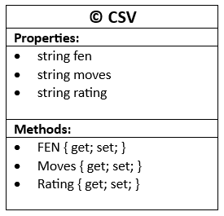
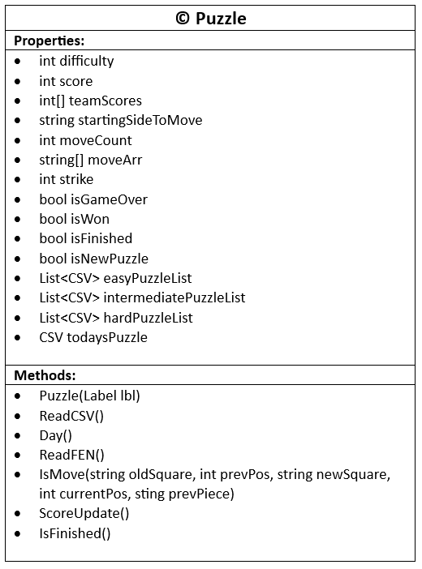
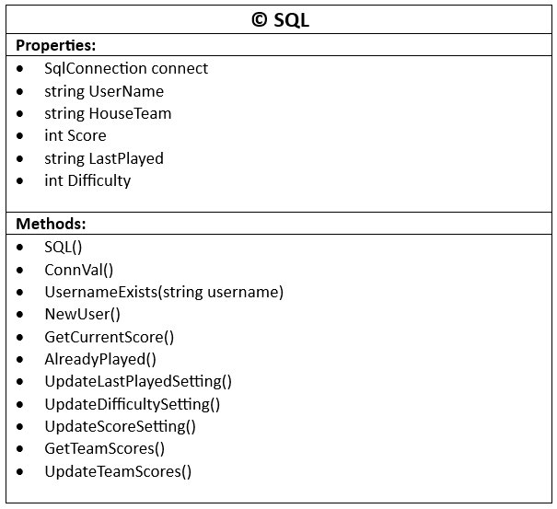
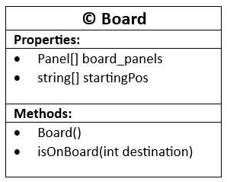
DESIGNER’s Statement: Classes

